Slide 1
Objective-Based Control for Intelligent Vehicles Under Uncertainty
James Fleming Loughborough University, UK
With thanks to my collaborators and colleagues:
Jakub Krol, Bani Anvari, Laura Justham, Mohammad Otoofi, Leo Laine, Roberto Lot, Neville Stanton, Xingda Yan, Leon Henderson, Qianyue Luo, Hui Zhang, Will Midgley

Slide 2
Introduction:
What do I mean by ‘objective-based’ control?
Why do we care about uncertainty?
Some methodologies and case studies:
Robust perception and sensing - road surface friction estimation from camera images
Control to meet objectives despite uncertainty - robust and stochastic MPC
What should the objectives be? – energy efficient ACC systems
Conclusion:
Some closing thoughts and open research questions

Slide 3
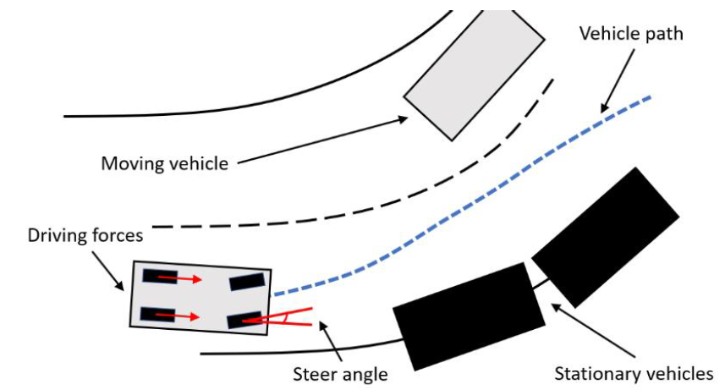
What is ‘objective-based’ control?
Methods that try to minimise/maximise an objective (cost or reward) function,
Can account for constraints, e.g. for collision avoidance (explicitly or via objective function)
Examples:
MPC and its variants (nonlinear, robust, economic…)
RL algorithms, like DDPG, TD3…
Control barrier functions resulting in QPs.... etc.
Why?
In complex situations, easier to specify goals, i.e. ‘what we want’ than ‘how to get it’
Can include ‘economic’ objectives, e.g. fuel/energy saving for the vehicle

Slide 4
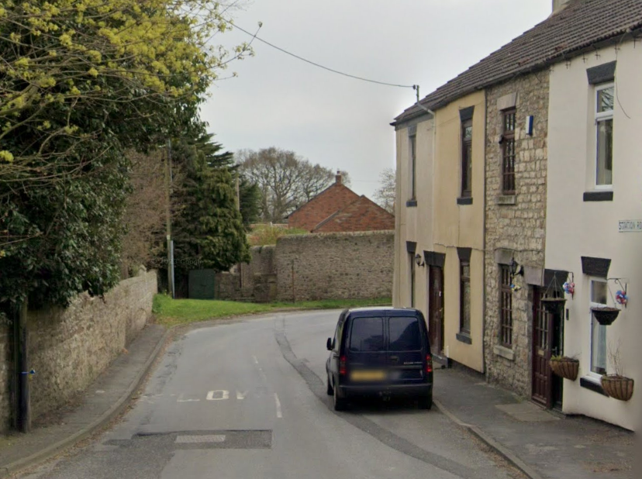
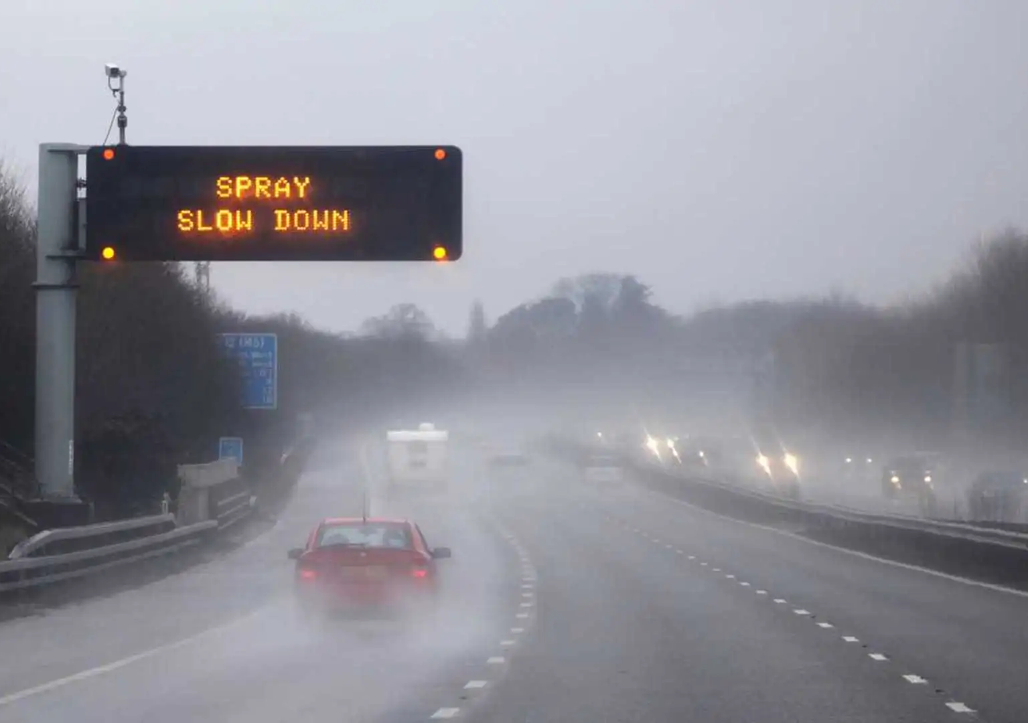
Motivation - why care about uncertainty?
Situations with limited visibility common while driving
Also changing weather conditions, reduced grip from tyres on road
If possible, should drive ‘defensively’ in these situations
How can we make controllers that do this ‘automatically’?
Some thoughts:
Need to make perception algorithms that are robust to reduced visibility
Design controllers that optimise/meet objectives despite this uncertainty
Ideally, perception algorithms should give some idea of the confidence of their detections/measurements
From Google Street View, ©Google, 2024
www.rac.co.uk/drive/advice/winter-driving/understanding-aquaplaning/ , ©RAC, 2024

Slide 5
Framework: objective-based control with uncertainty
State/parameter estimates
Perception algorithms
Objective-function based controller
Autonomous vehicle
Control actions
Confidence / uncertainty estimate
Can we do this with current methods?

Slide 6
Introduction:
What do I mean by ‘objective-based’ control?
Why do we care about uncertainty?
Some methodologies and case studies:
Robust perception and sensing - road surface friction estimation from camera images
Control to meet objectives despite uncertainty - robust and stochastic MPC
What should the objectives be? – energy efficient ACC systems
Conclusion:
Some closing thoughts and open research questions

Slide 7
Uncertainty in perception
How to make perception methods that are robust to uncertainty, and give uncertainty estimates?
Classically - (extended) Kalman filter provides an uncertainty estimate via covariance matrix!
e.g. in mobile robotics EKF-based SLAM can give covariance matrices for position.
However, modern vehicles now have cameras, lidar…
These give complex, high-dimensional data, typically processed with ML - how to make perception robust and get uncertainty estimates?

Slide 8
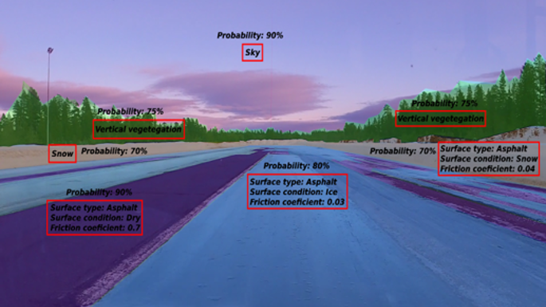
Case study: friction estimation
Recent collaboration with Volvo Trucks in Sweden
Estimate friction coefficient and surface type/condition​
Combined regression and semantic segmentation problem, using a camera on the truck
Semantic seg. commonly studied in the ML community, but to date few studies considering e.g. ice, snow, wet asphalt surfaces
Would like a method lightweight enough to run in real time ~ 10Hz

Slide 9
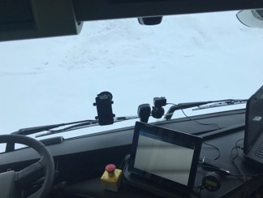
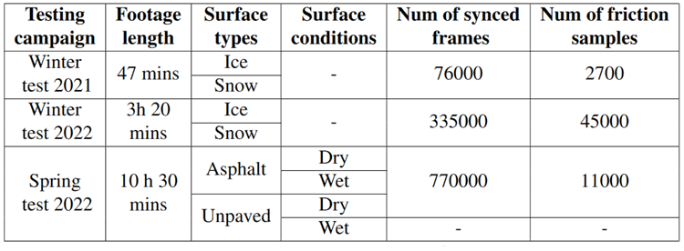
Data collection
GoPro camera
Data logger
RT3000 data collection (acceleration, gyro)
Truck CANbus signals
Three test campaigns, carried out with assistance of Volvo Trucks in Sweden
Different surface types and conditions
1700 vehicle dynamic responses

Slide 10
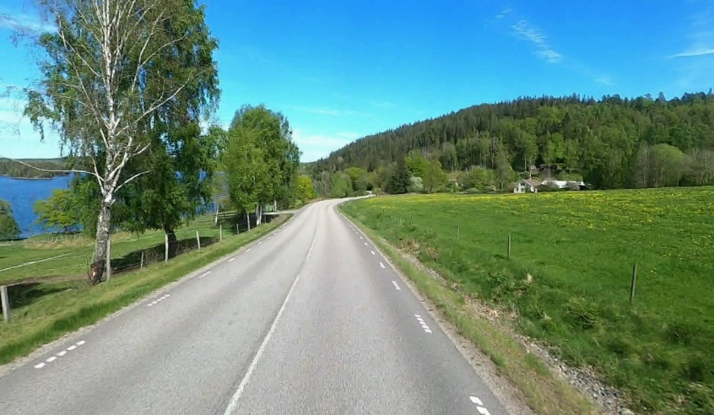
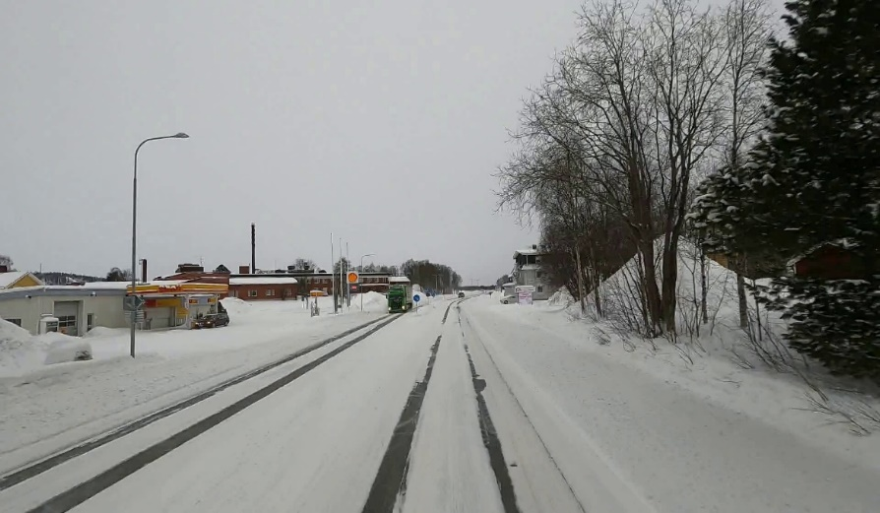
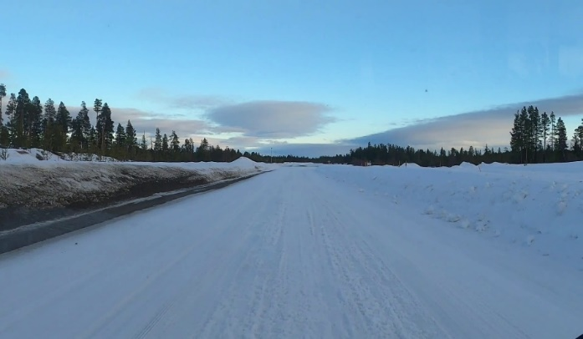
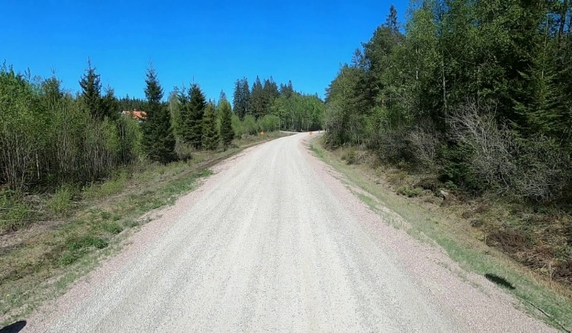
Some examples of road scenes in dataset

Slide 11
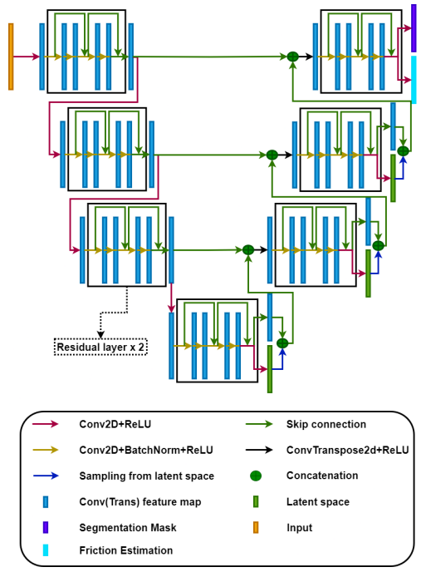
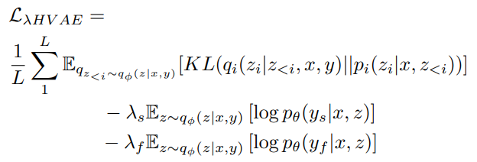
Deep learning Model for friction estimation
Conditional Variational Autoencoder (CVAE)
‘U-net’ encoder-decoder architecture, now popular in medical image segmentation, a generative model
Learns low-dimensionality ‘latent spaces’ on which the data is approximately normally distributed – improve robustness
Friction estimation also from the CVAE
Model trained to perform regression and classification of image pixels simultaneously
Semantic understanding of surface type and condition (hopefully) benefits friction estimation

Slide 12
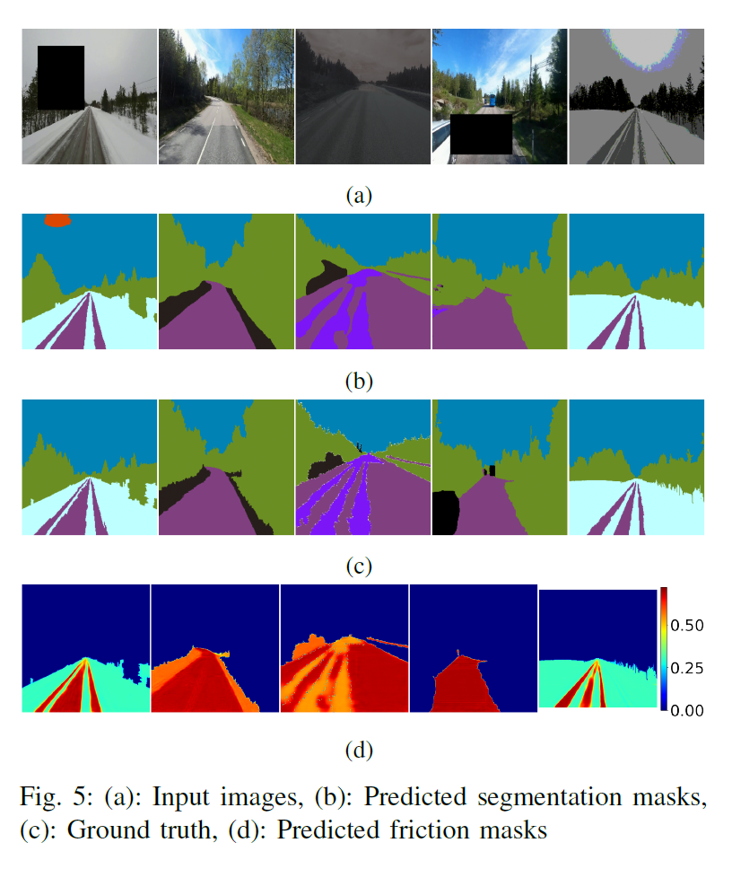
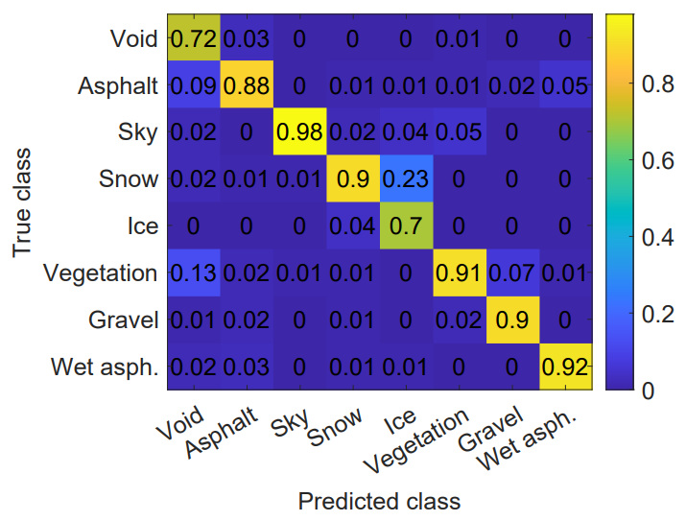
Semantic segmentation: results

Slide 13
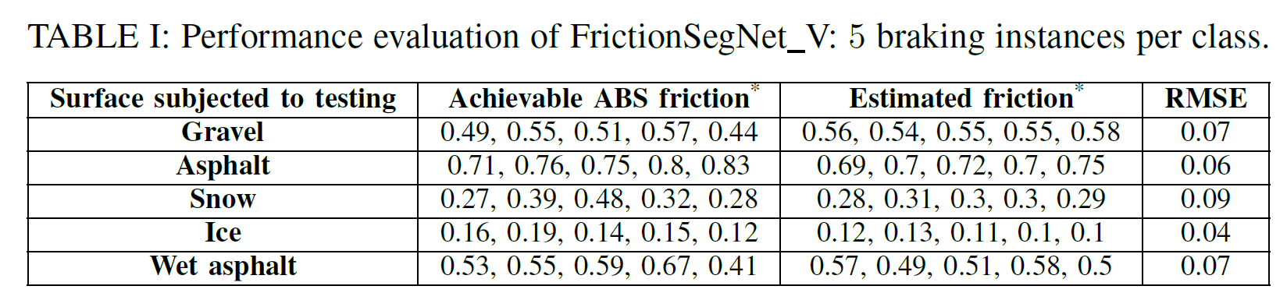
Friction estimation: results
Also tested the friction estimation performance using several ABS assisted stops on a test track in Sweden:
Performance for classification of surface type and friction estimation seems good
Snow is sometimes (~20%) misclassified as ice, but also hard to distinguish for humans.

Slide 14
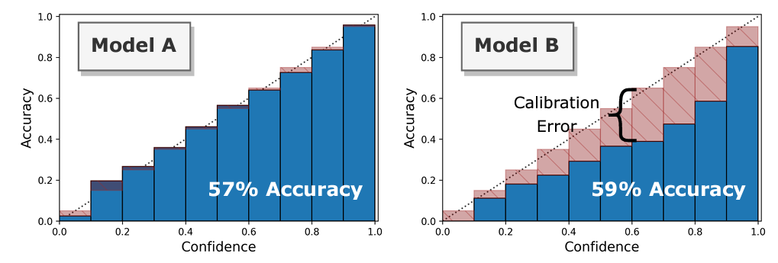
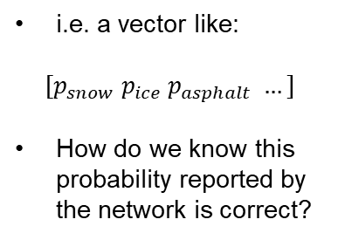
Perception: how to get uncertainty estimates?
In principle, final ‘softmax’ layer gives a probability distribution – actually $p(y|x)$, the conditional distribution of the output given the data – i.e. quantifies the uncertainty
i.e. a vector like:
$$[p_{snow} p_{ice} p_{asphalt} …]$$
How do we know this probability reported by the network is correct?
Well-calibrated
Overconfident
Much of the ML literature focuses on improving accuracy, not calibration...
For surface type and condition task, we are investigating how to improve calibration (currently overconfident)

Slide 15
Introduction:
What do I mean by ‘objective-based’ control?
Why do we care about uncertainty?
Some methodologies and case studies:
Robust perception and sensing - road surface friction estimation from camera images
Control to meet objectives despite uncertainty - robust and stochastic MPC
What should the objectives be? – energy efficient ACC systems
Conclusion:
Some closing thoughts and open research questions

Slide 16
What control methods can account for uncertainty?
If we have uncertainty estimates, what (objective-function based) control methods can use them?
Nowadays, lots of robust and stochastic MPC methods are known!
Stochastic methods can exploit knowledge of distribution of uncertainty
Why MPC? Can use model to predict effect of uncertain parameters, additive disturbances, etc – many types of system & uncertainty considered in literature
The above is also true for model-based RL, but no stability/performance guarantees
This isn’t a talk about MPC, so no gory details here, instead an example…

Slide 17
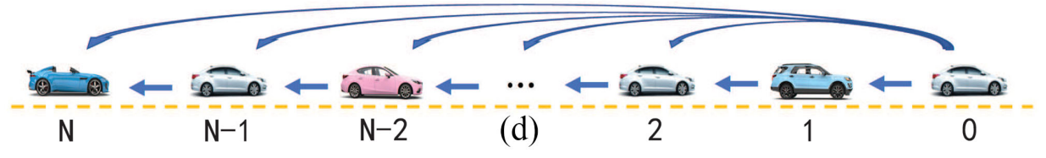
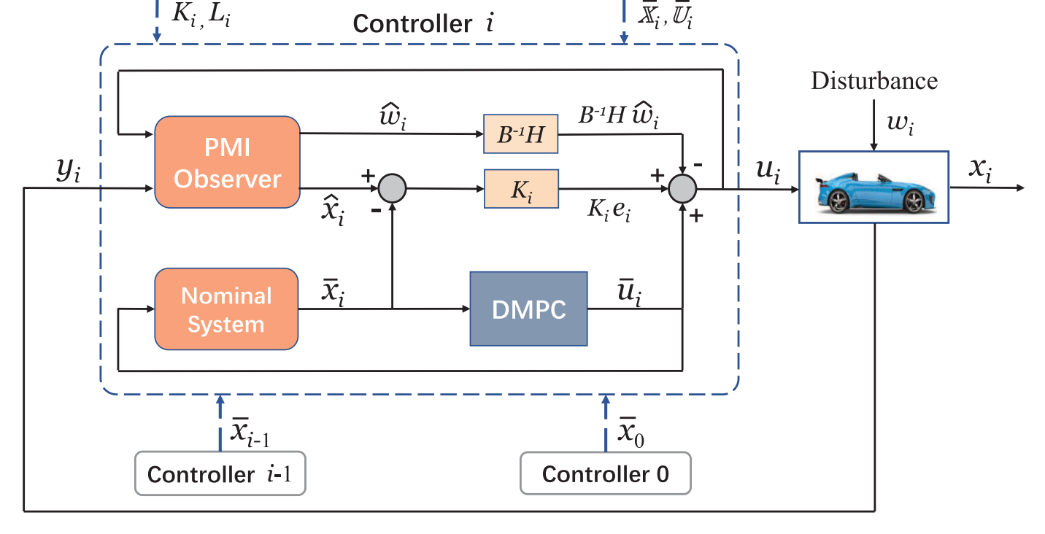
Example: Robust MPC for vehicle platoon control
Collaboration with researchers at Beihang University
Acceleration and braking control of a vehicle platoon, with communication from leader and to followers
State constraints to avoid collisions between vehicles, each vehicle controlled by a tube MPC robust to additive disturbances
Also considered using an observer to estimate the disturbance

Slide 18
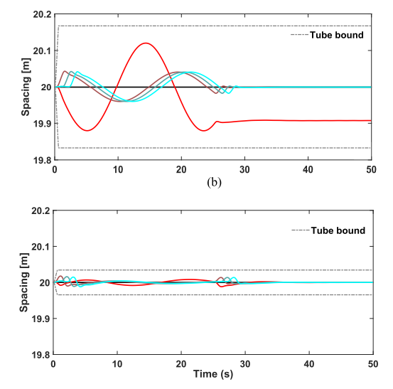
Example: Robust MPC for vehicle platoon control
Simulation results showed that estimating the disturbance could improve performance
Some nice theoretical properties: recursive feasibility, stability, assuming the disturbance is bounded
Robust MPC:
With observer for disturbance:
*Luo, Q., Nguyen, A.T., Fleming, J. and Zhang, H., 2021. Unknown input observer-based approach for distributed tube-based model predictive control of heterogeneous vehicle platoons. IEEE Transactions on Vehicular Technology, 70(4), pp.2930-2944.

Slide 19
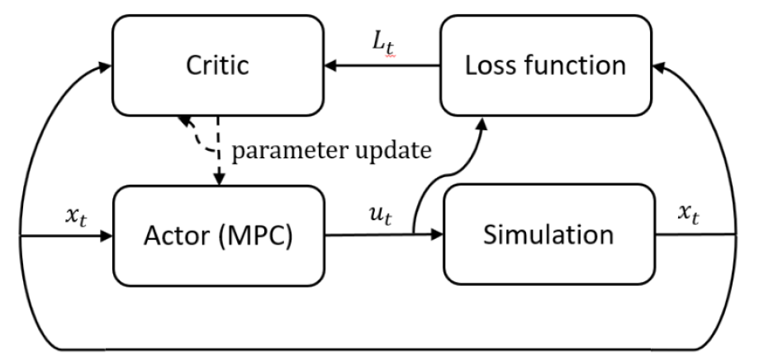
Current EPSRC grant at LU
“Learning of safety critical model predictive controllers for autonomous systems” (EP/X015459/1)
Two current ‘objective-based’ approaches:
MPC (safety guarantees, but complex to design and implement, must redesign for every vehicle)
Reinforcement learning – (‘design’ is easy as it is automated, but no stability/feasibility guarantees)
Idea: Can we ‘reinforcement learn’ an MPC controller in an actor-critic framework?
Could give us the best of both worlds, i.e. a safe controller that is learned automatically from data.

Slide 20
Introduction:
What do I mean by ‘objective-based’ control?
Why do we care about uncertainty?
Some methodologies and case studies:
Robust perception and sensing - road surface friction estimation from camera images
Control to meet objectives despite uncertainty - robust and stochastic MPC
What should the objectives be? – energy efficient ACC systems
Conclusion:
Some closing thoughts and open research questions

Slide 21
What objectives would we like to optimise?
We can distinguish between:
Near-term, measurable control objectives, expressible as an objective function, that you might include e.g. in MPC or RL
Longer-term objectives that are wider requirements or goals for the system, but that don’t obviously relate to some objective function
Examples:
Safety / collision avoidance
Minimisation of journey time
Energy efficiency
User acceptance
Have beneficial effects on traffic
What objective functions should we specify for these?

Slide 22


Case study: Energy-saving ACC systems
EPSRC project “Green Adaptive Control for Future Interconnected Vehicles”:
Aimed to develop energy saving optimal control methods for adaptive cruise control (eco-ACC) or autonomous vehicles, with good user acceptance.
Just driving more slowly is not an option (poor user acceptance). We would like to account for preferences on speed, acceleration, following distances.
Example: How to decelerate before stop signals?
Potential impact:
Combustion engine vehicles: “The difference in fuel consumption and emissions due to driving behaviour can be up to 25% in urban areas” (UDRIVE project, D45.1)
Electric vehicles: Experimental studies on eco-driving assistance have shown ~15% reduction in energy usage (e.g. Dib et al, 2014, “Optimal energy management for an electric vehicle in eco-driving applications”, Control Engineering Practice)

Slide 23
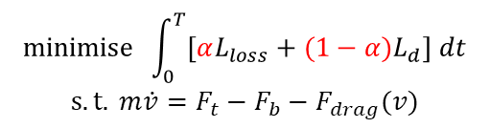
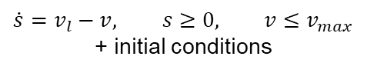

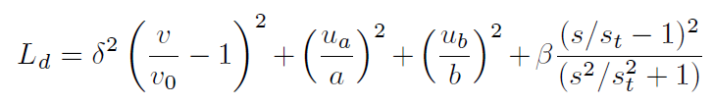


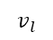


Energy-saving ACC as an optimal control problem
Driving to minimise energy loss is an optimal control problem (OCP), can solve it numerically to control vehicle
We add a term to blend energy-saving behaviour with typical human behaviour – for better user acceptance.
For ACC, it turns out that human car-following behaviour is well-represented by a cost function of the form*:
Energy usage
Human preferences
*Fleming et al, 2020. “Incorporating driver preferences into eco-driving assistance systems using optimal control”. IEEE Trans. on Intelligent Transportation Systems.
Can implement in practice using economic / nonlinear MPC
Useful: avoids unnatural behaviour, improves user acceptance compared to minimising energy

Slide 24
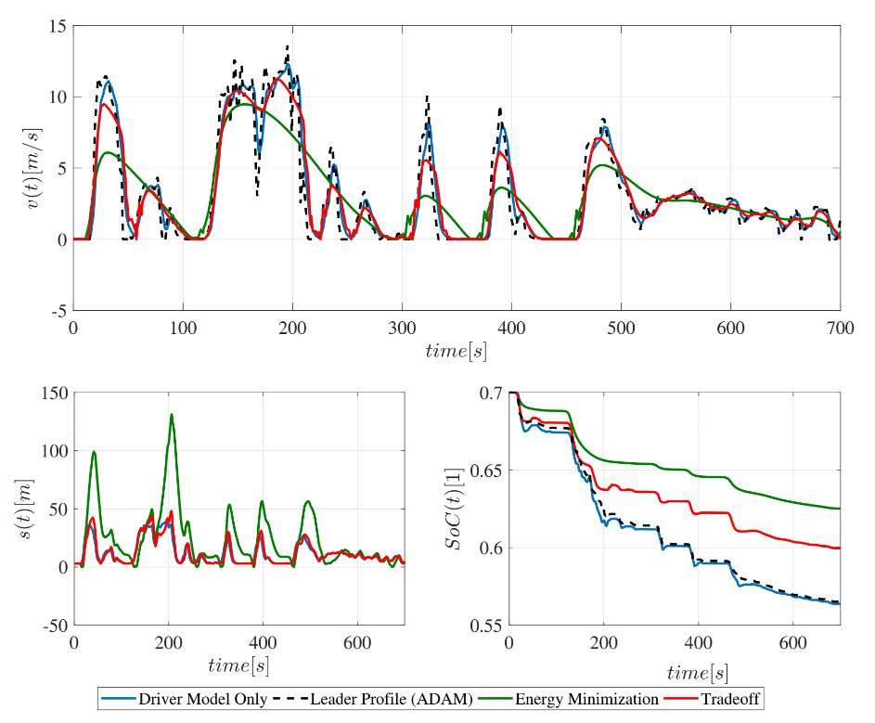
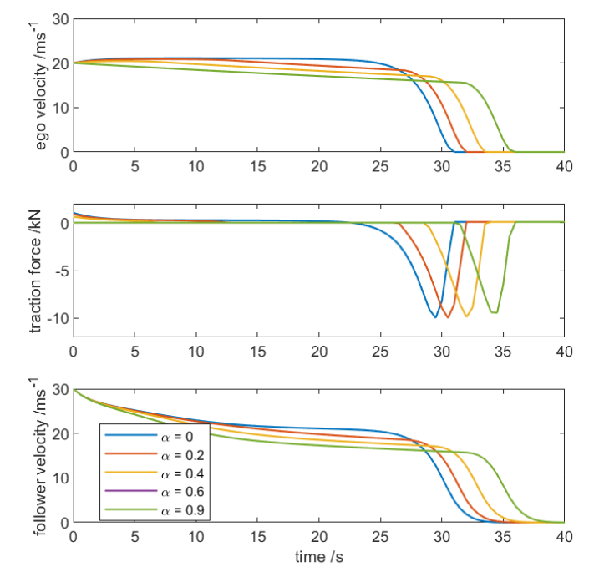
Results: Energy saving ACC
Human preferences
Real-world car-following data example:
(true energy-minimisation behaviour is unnatural!)
Stop signal example: Variable coasting behaviour

Slide 25
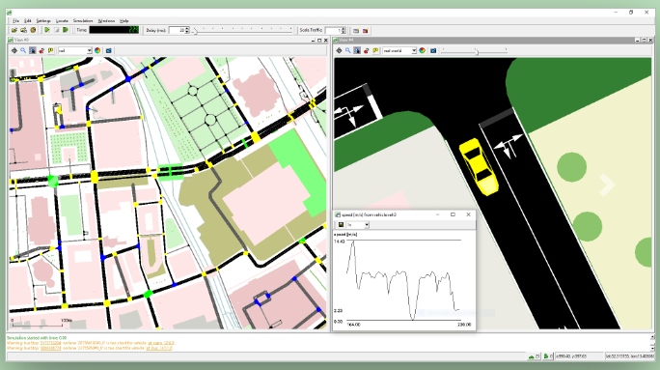
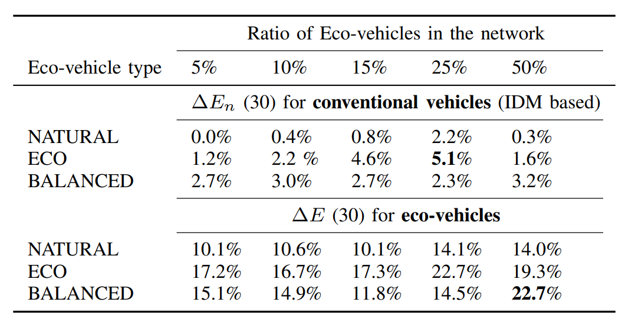
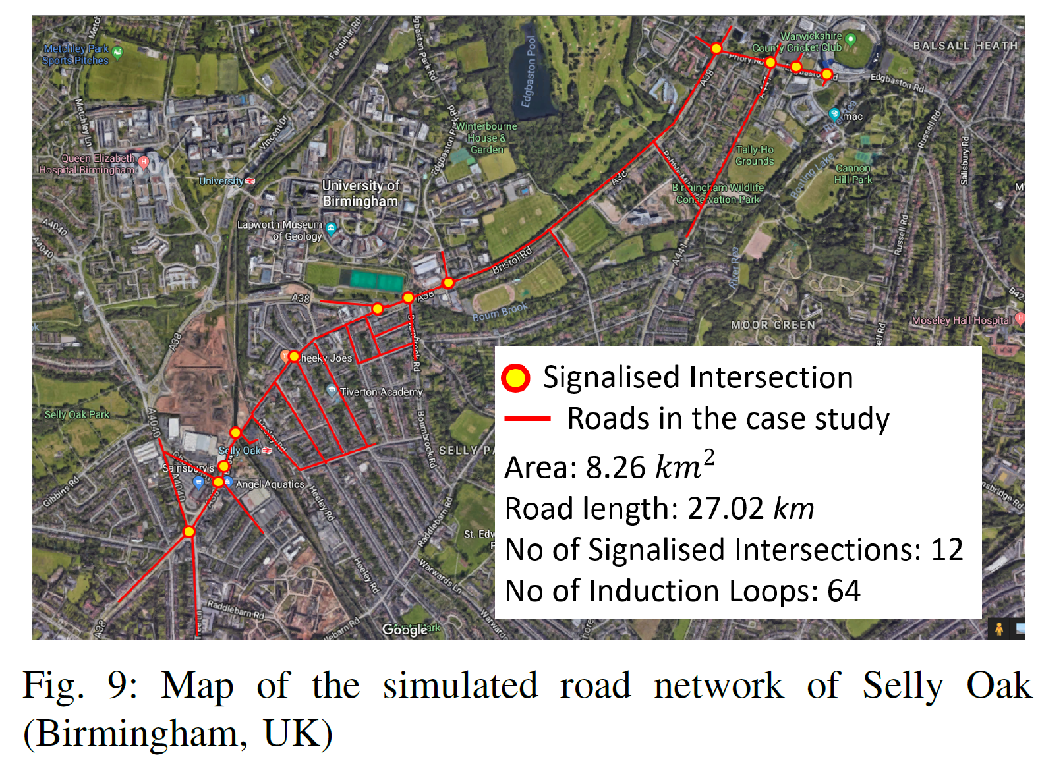
Case study: effect on other traffic?
What is the wider effect of driving like this on other traffic?
Recent results of a collaboration with researchers at UCL using SUMO microscopic traffic simulation:
Also saves energy for other vehicles following ours,
(e.g. by coasting down before stop signals)
no/negligible increase in travel times.

Slide 26
Introduction:
What do I mean by ‘objective-based’ control?
Why do we care about uncertainty?
Some methodologies and case studies:
Robust perception and sensing - road surface friction estimation from camera images
Control to meet objectives despite uncertainty - robust and stochastic MPC
What should the objectives be? – energy efficient ACC systems
Conclusion:
Some closing thoughts and open research questions

Slide 27
Framework: objective-based control with uncertainty
State/parameter estimates
Perception algorithms
Objective-function based controller
Autonomous vehicle
Control actions
Confidence / uncertainty estimate
Can we do this with current methods?

Slide 28
Conclusions and current challenges
ML models for perception can estimate probabilities of states/parameters
But… many methods aim for high accuracy, not good calibration of probabilities
There are now lots of methods for stochastic/robust MPC
But… complex to implement, takes expert knowledge to design for each vehicle
Using economic objectives, controllers can save energy / increase range
Can we also design objective functions that promote other goals, such as user acceptance, improved traffic flow, etc?

